Slide 1
MESS MANAGEMENT
ABHIJIT SARKAR(20BCS006)
ABHIRAJ RAM(20BCS009)
ADARSH KUMAR(20BCS016)

Slide 2
WHY WE NEED MESS MANAGEMENT SYSTEM
Mess management system project is a project to manage all the basic functionalities of any Mess/restaurant like record register new user, delete user, manage daily attendance, check mess progress etc.
Mess management system project is useful for providing some functionalities online so that users can know about the mess/restaurant like what is the today’s meal, what is the full week menu, user’s feedback and review etc.

Slide 3
Software used
We have used some basic software/tool to create this mess management system project that are listed below –
Text editor (Visual Studio code)
Web browser (Google Chrome)
Local server (Wamp server)
MySQL database
Bootstrap

Slide 4
Working of the project –
We have divided mess management system project in two panels –
User Panel
Admin panel

Slide 5
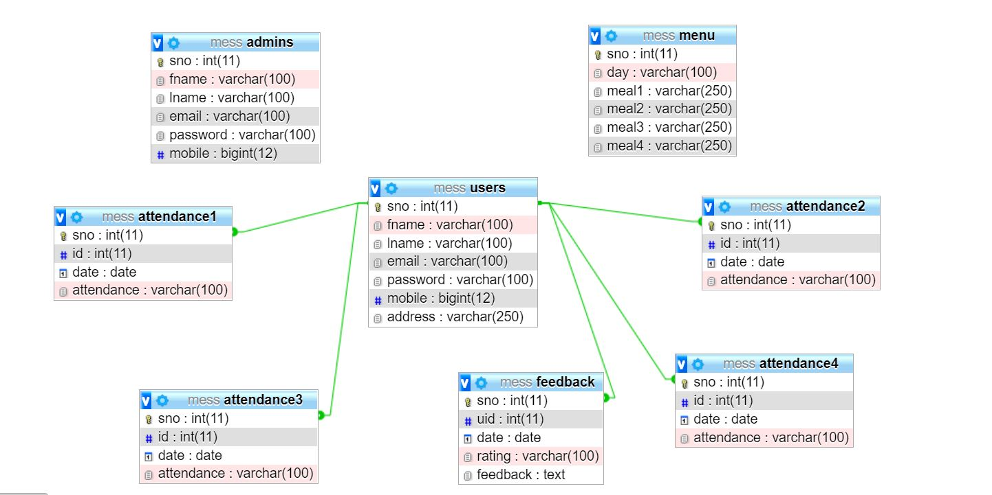
RELATIONAL MODEL

Slide 6
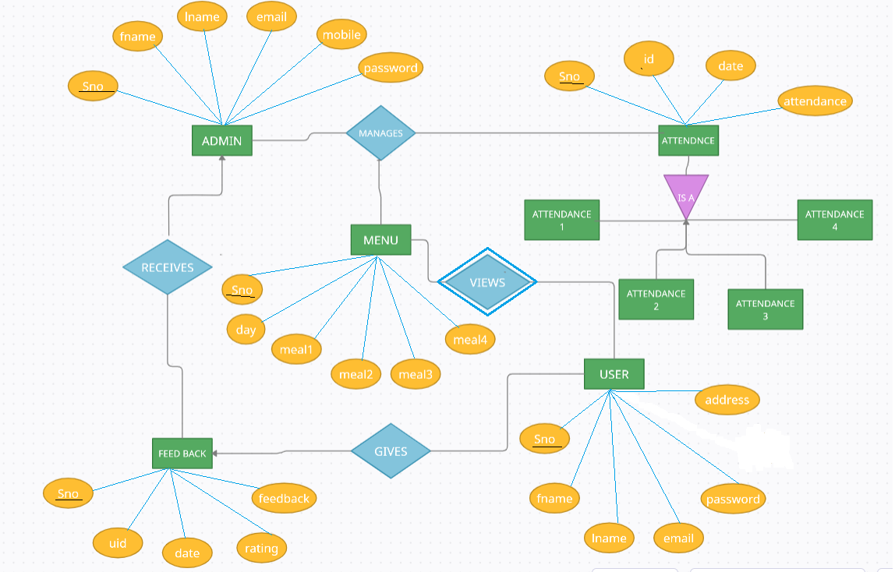
ER MODEL

Slide 7
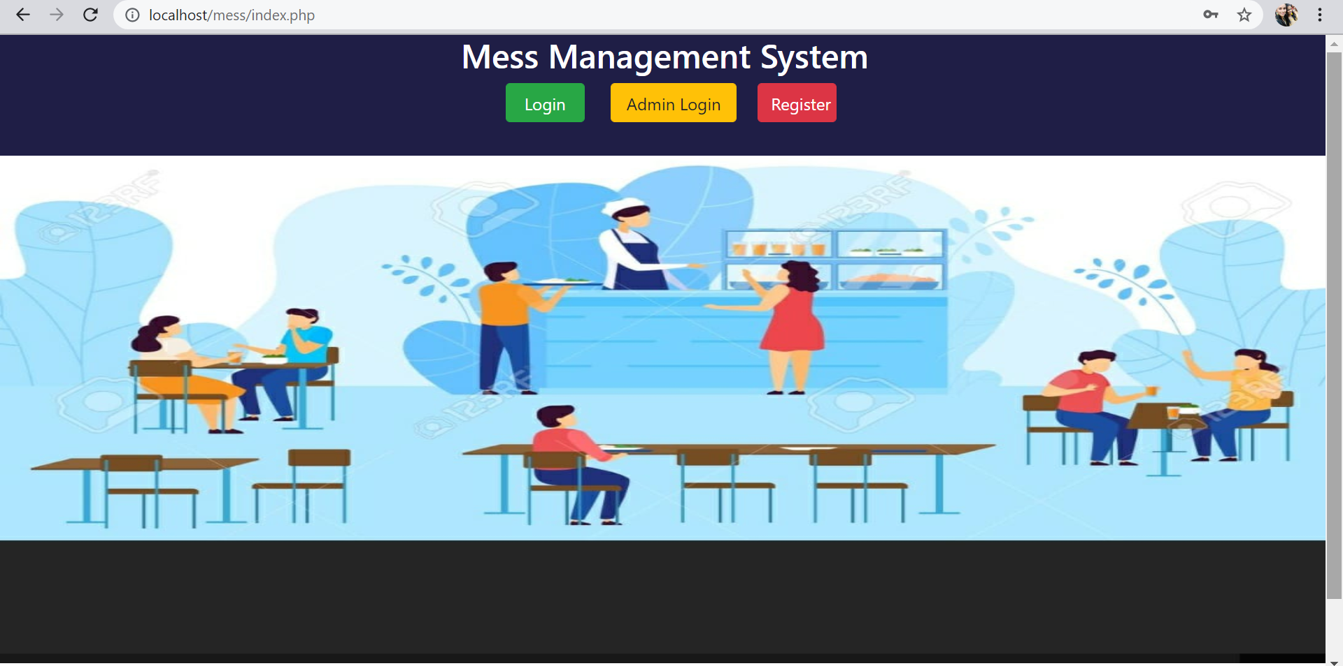
HOME PAGE

Slide 8
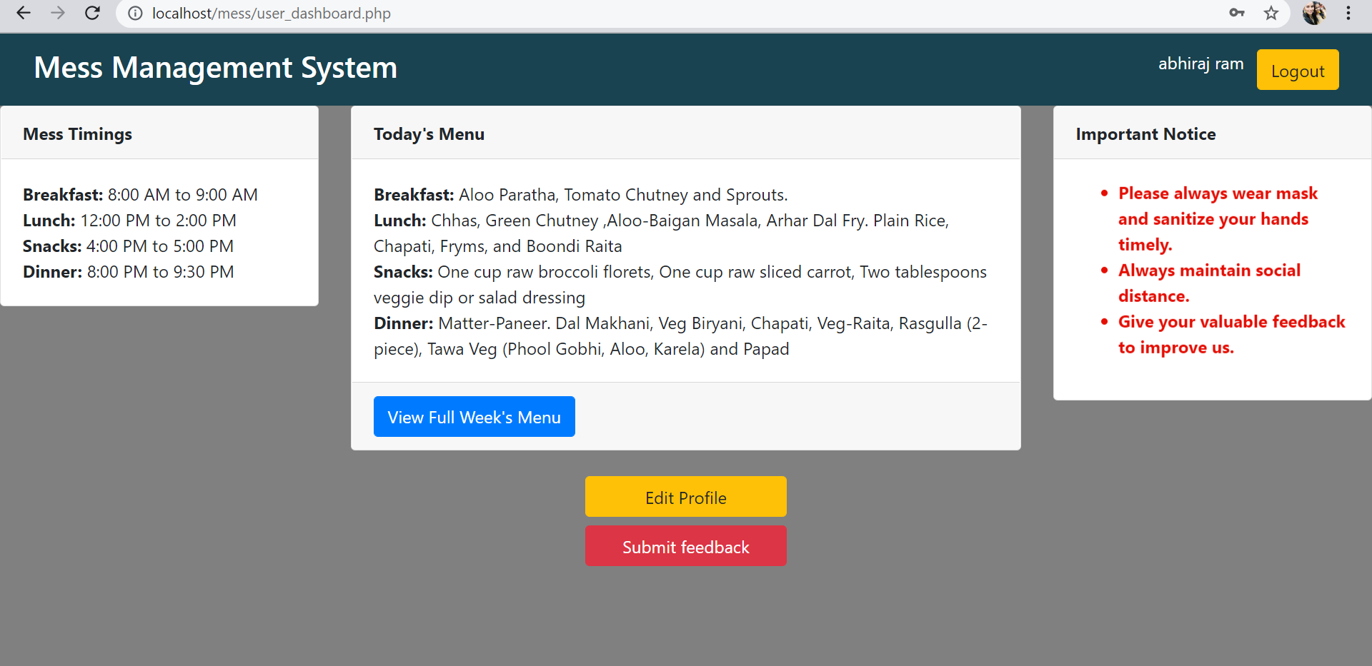
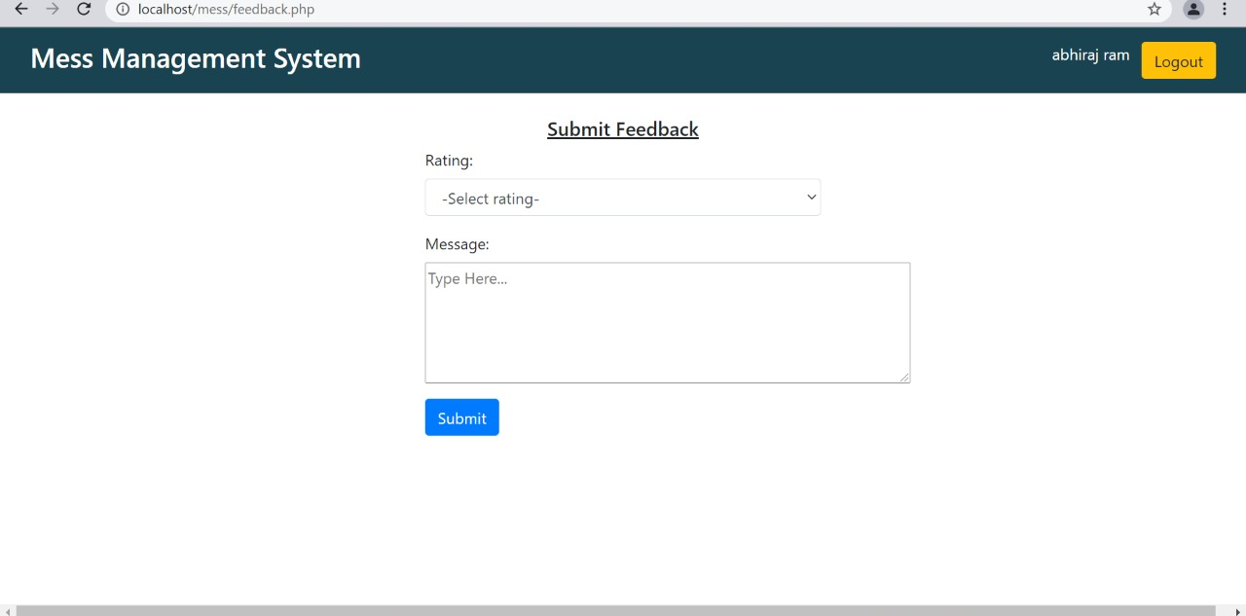
USER INTERFACE
FEEDBACK PANEL
USER PANEL

Slide 9
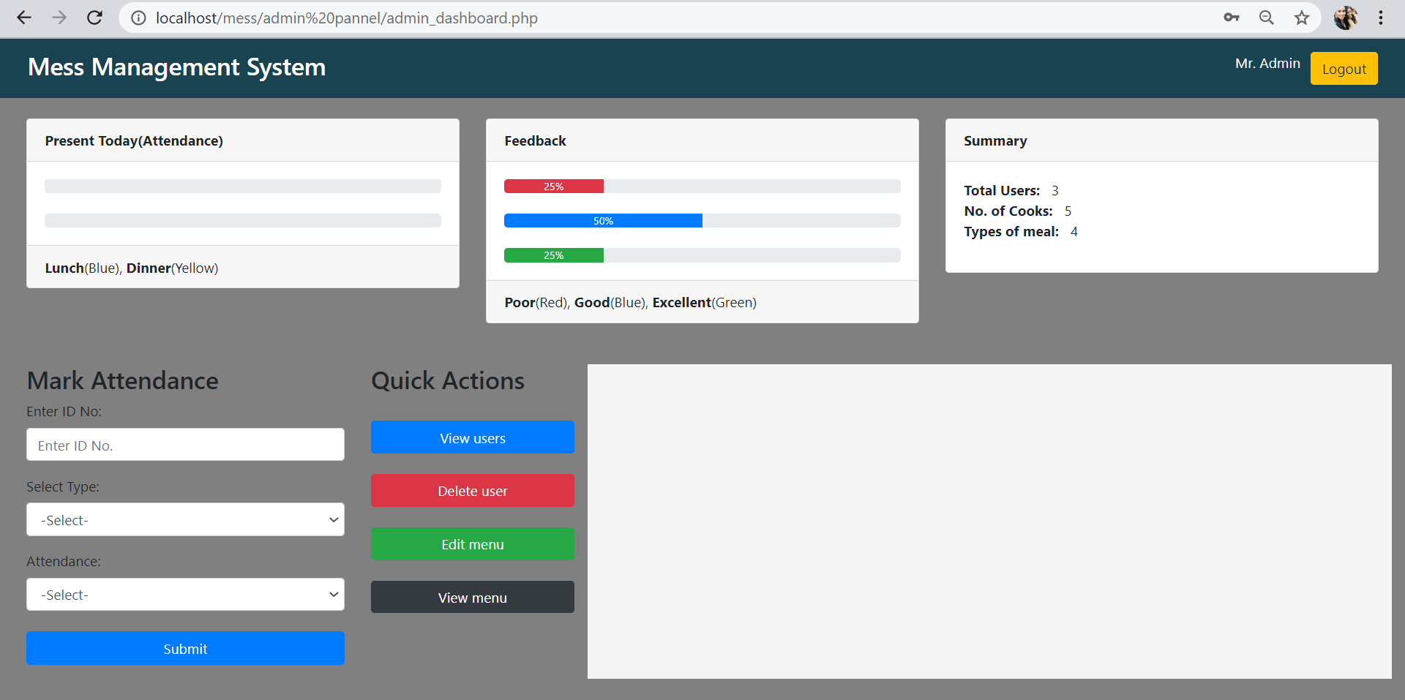
ADMIN INTERFACE

Slide 10
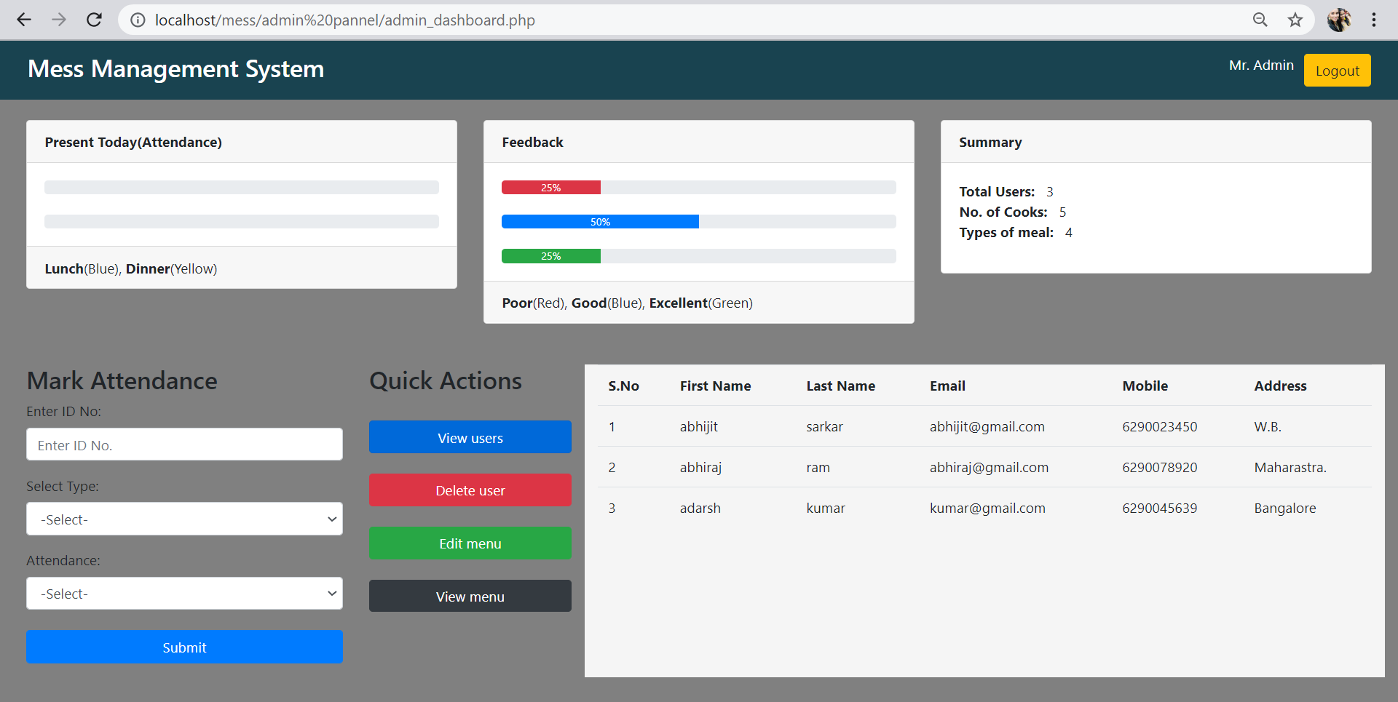
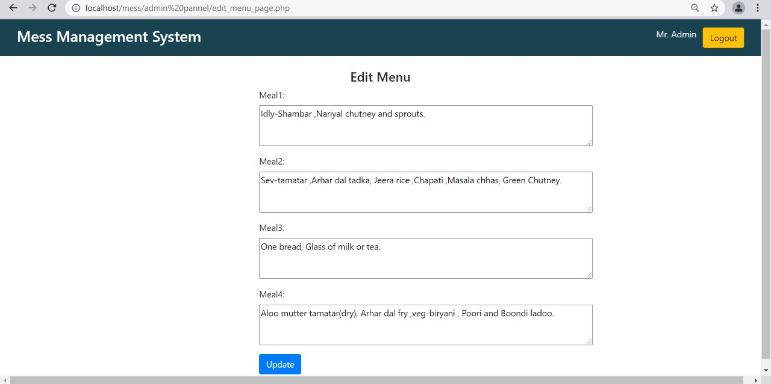
ADMIN INTERFACE
EDIT MENU PANEL
VIEW USER FUNCTIONALITY

Slide 11
THANK YOU

